Slide 1
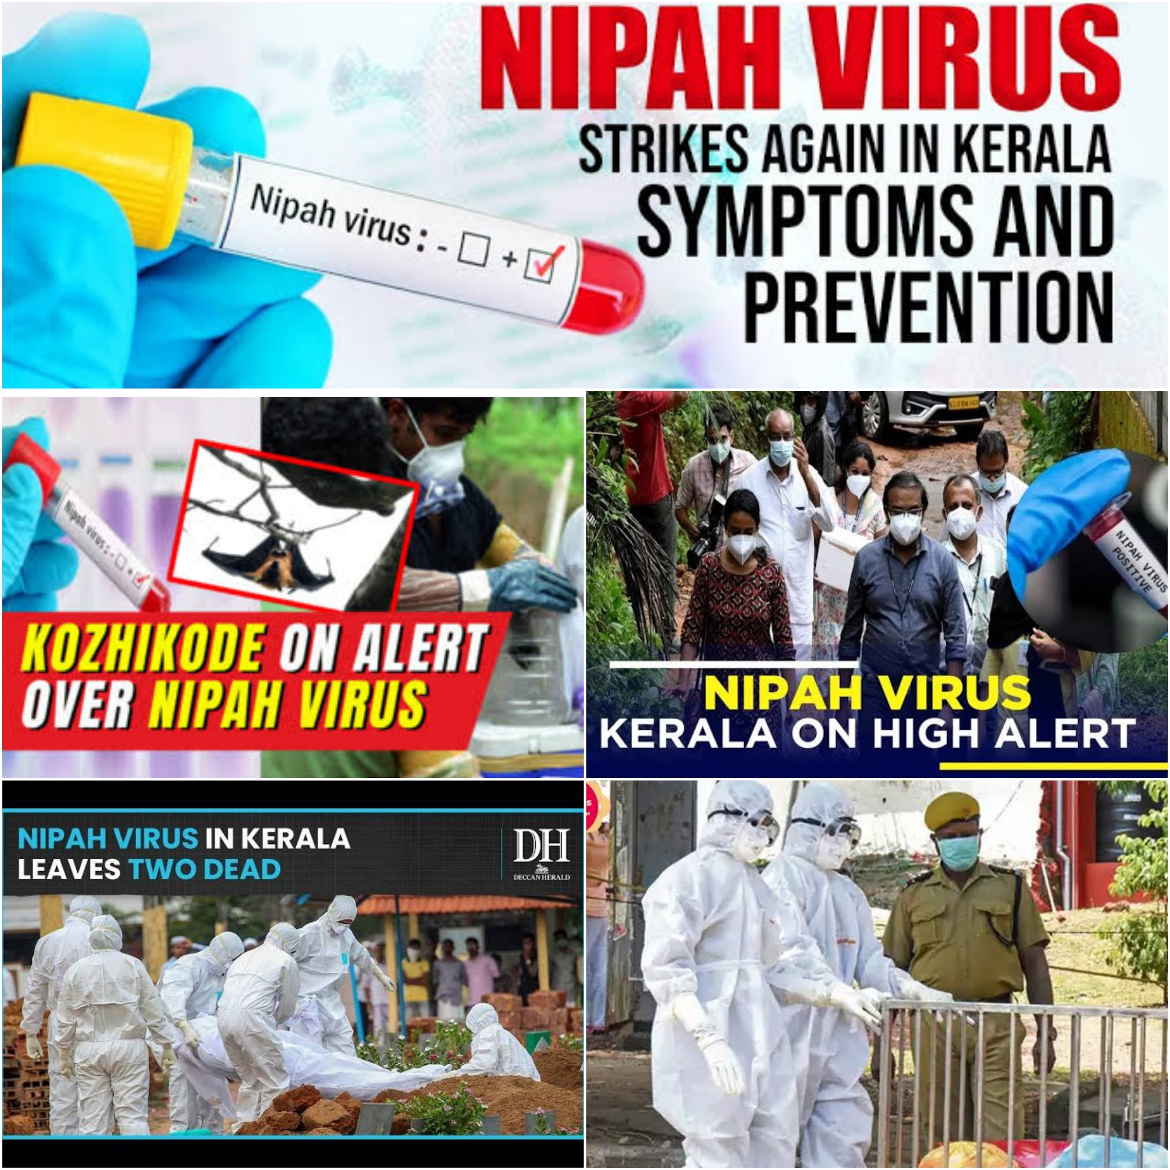
Outbreak of Nipah Virus:
A Deadly Zoonotic Pathogen

Slide 2
What’s an outbreak?
A disease outbreak is the occurrence of cases of disease in excess of what would normally be expected in a defined community, geographical area or season.
Outbreaks are maintained by infectious agents that spread directly from person to person, from exposure to an animal reservoir or other environmental source, or via an insect or animal vector. Human behaviours nearly always contribute to such spread.

Slide 3
Past outbreaks :
Human Nipah virus (NiV) infection is an emerging zoonotic disease which was first recognized in a large outbreak in Malaysia and Singapore in 1998.
In INDIA , during 2001 and 2007 two outbreaks in human were reported from west Bengal. There is circumstantial evidence of human to human transmission in India in 2001.
During the outbreak in Siliguri, 33 health workers and hospital visitors become ill after exposure to patients with Nipah virus, which suggested it is nosocomial infection.
In 2018, an outbreak of Nipah virus was reported in the same Kozhikode and Malappuram districts of Kerala with 18 confirmed cases and 17 deaths.

Slide 4
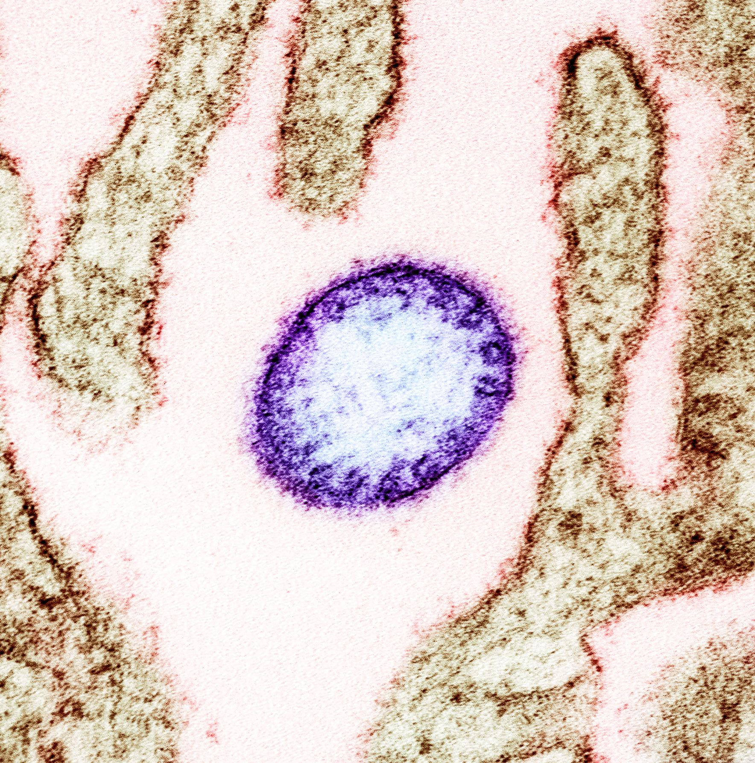
Epidemiology
AGENT : Nipah is a zoonotic RNA virus belonging to the Paramyxoviridae family under the genus Henipavirus
SEASONALITY: strongly implicated in NiV outbreak in Bangladesh and India. All of the outbreaks occurred during the months of winter to spring(december to may).

Slide 5
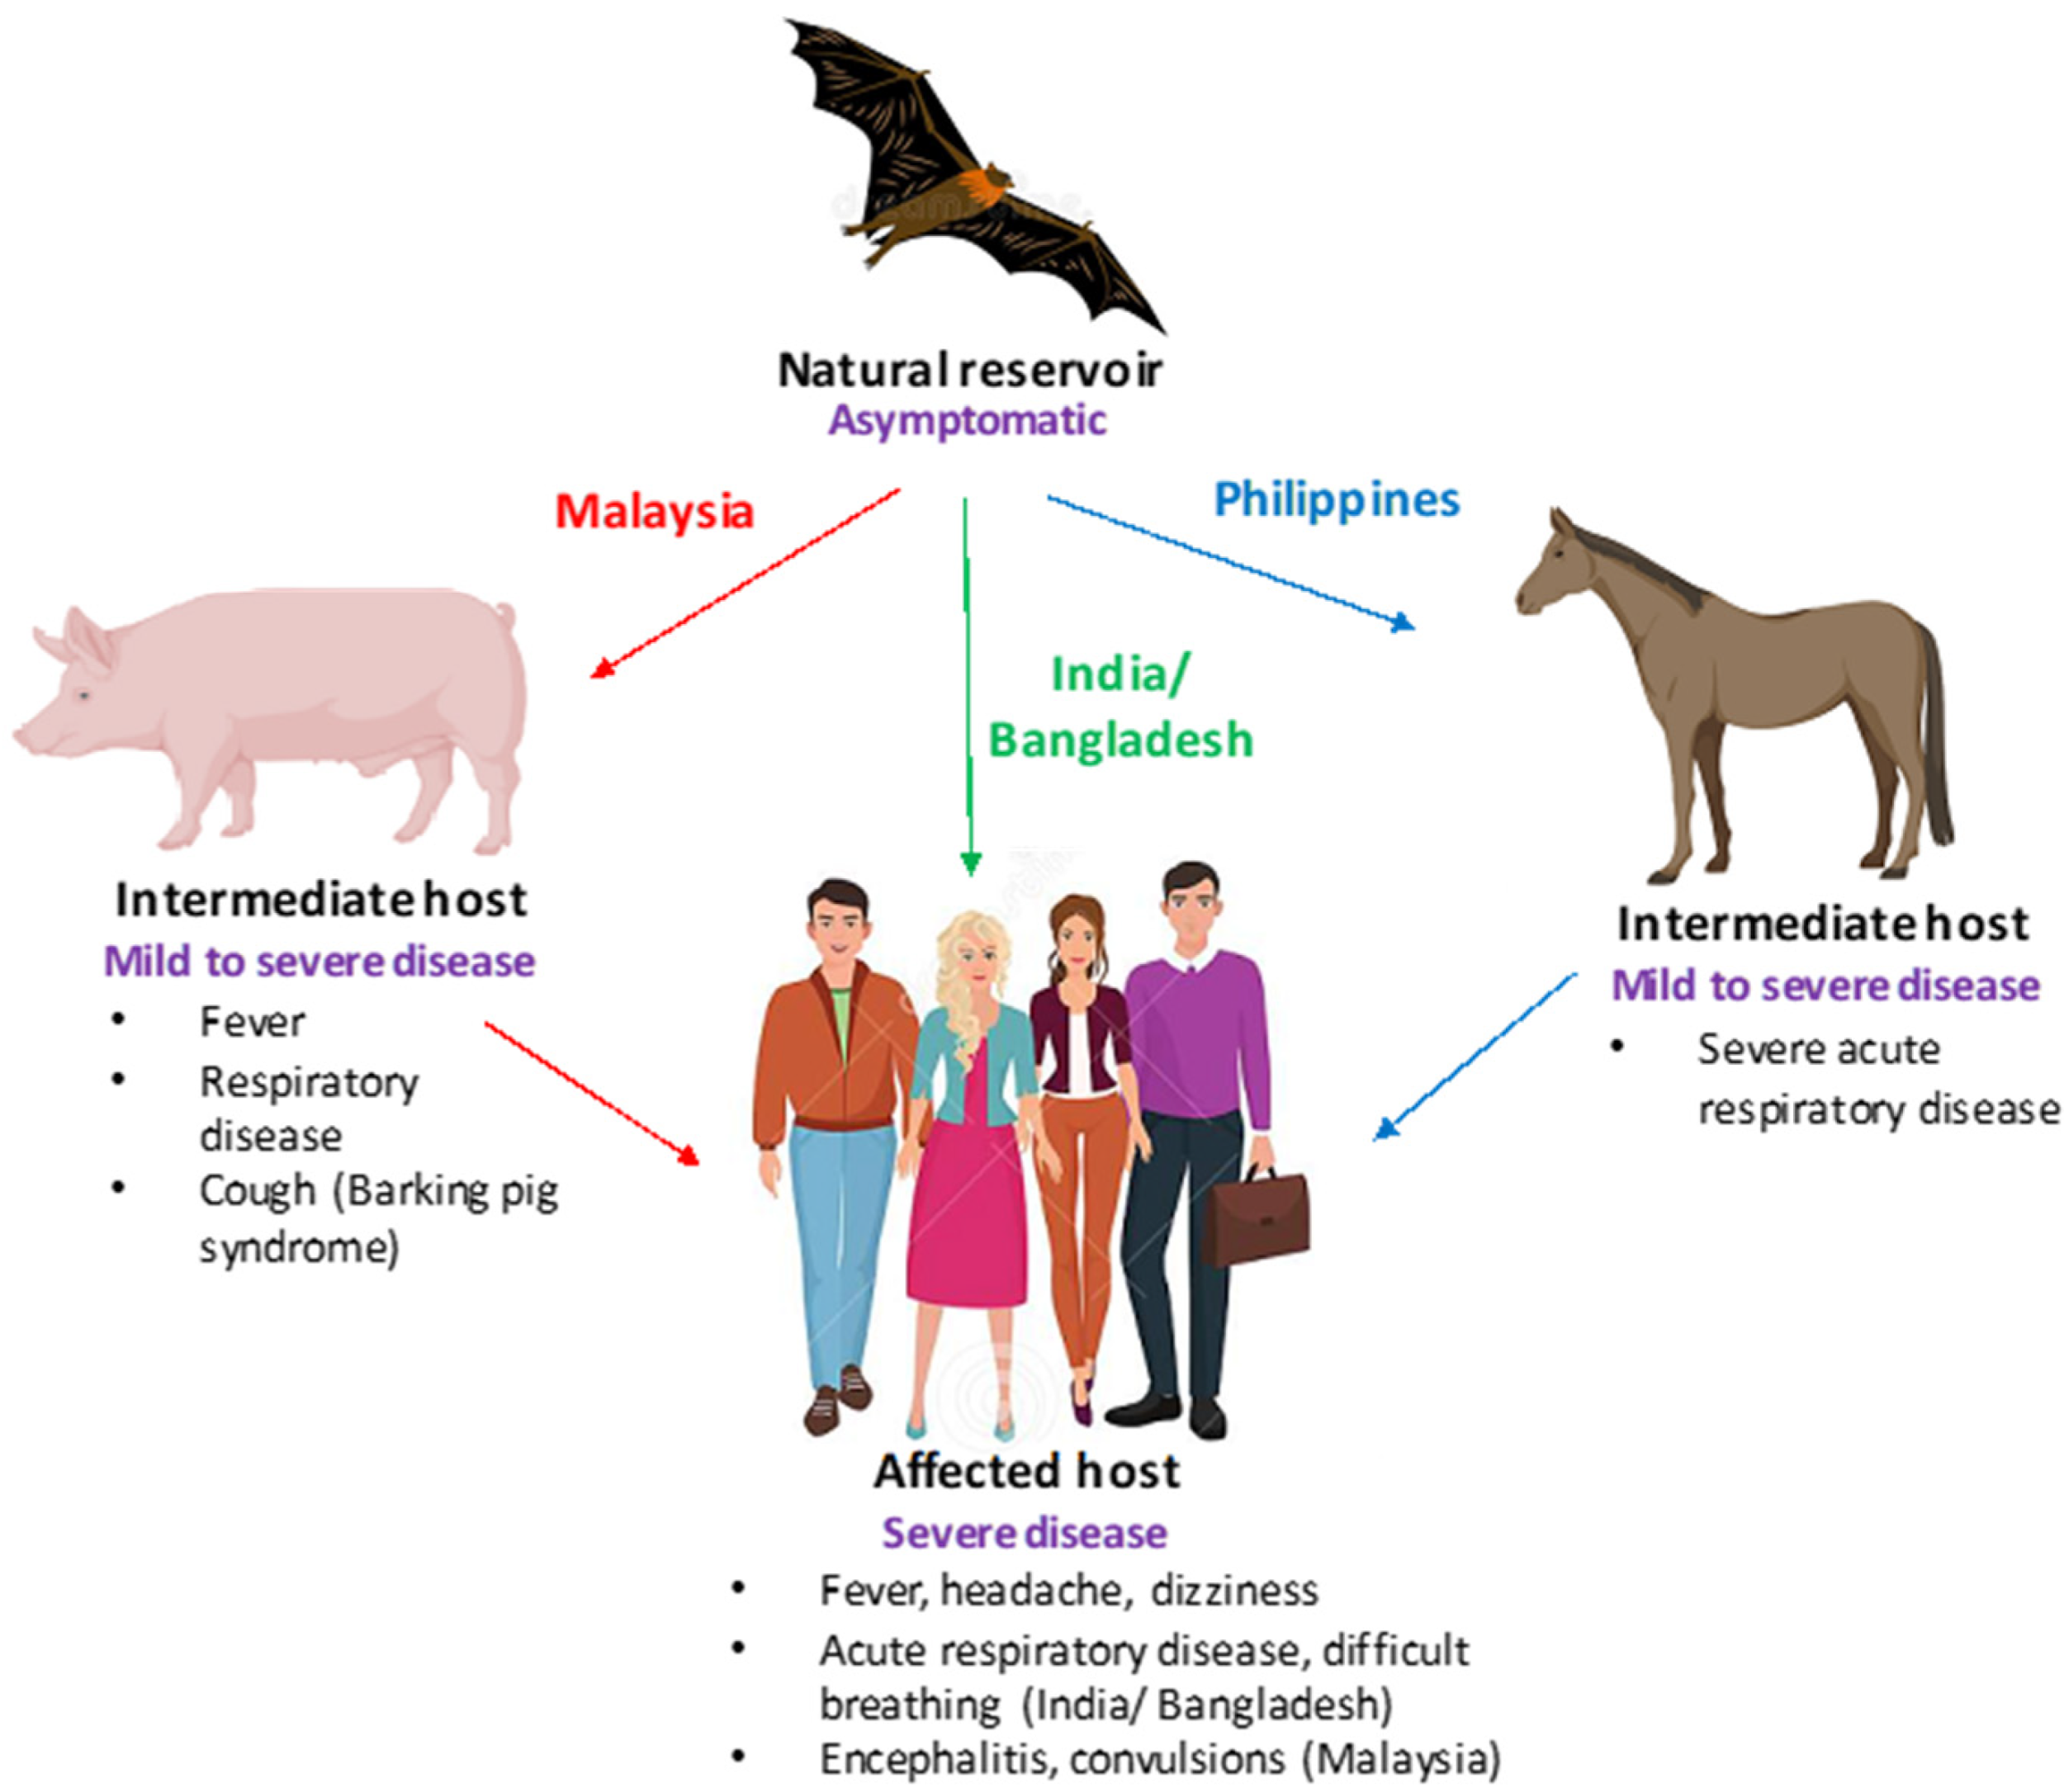
Natural reservoir: Laege fruit bats of pteropus genus are the natural reservoir of NiV.
Presumably, pigs may become infected after consumption of partially bat eaten fruits that are drpped in pegsites.
Primary Animal Reservoir
Fruit Bats / Flying Foxes
Intermediate Host
Pigs, Cats, Dogs, Horses

Slide 6
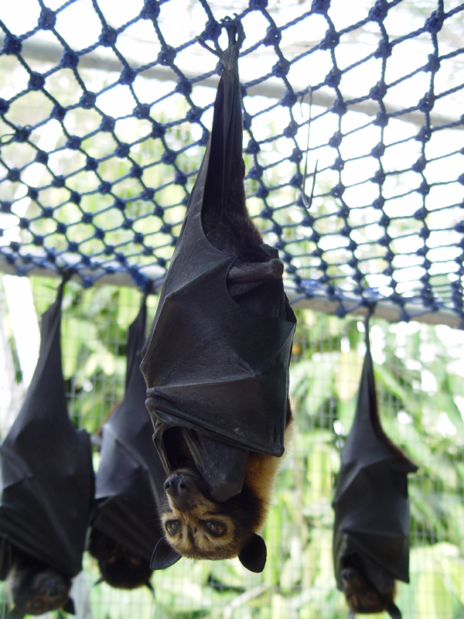
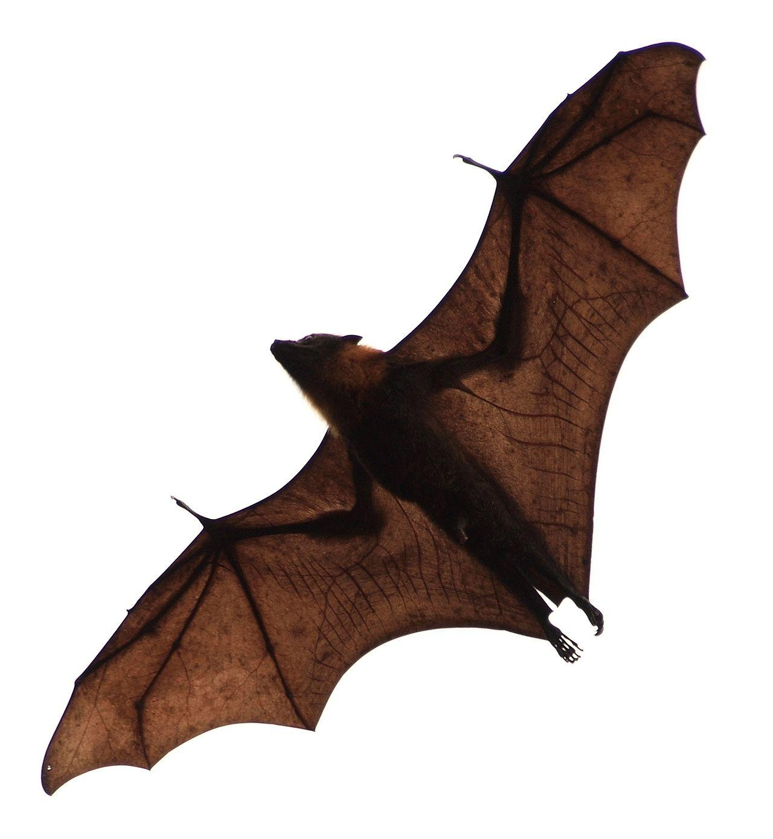
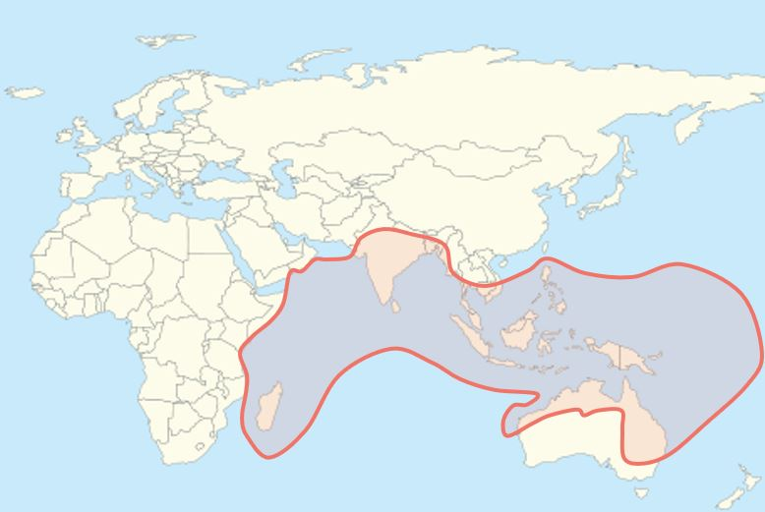
Fruit bats, also called flying foxes, are the animal reservoir for NIPAH VIRUS in nature
Geographic Distribution of Pteropus - NIPAH BELT

Slide 7
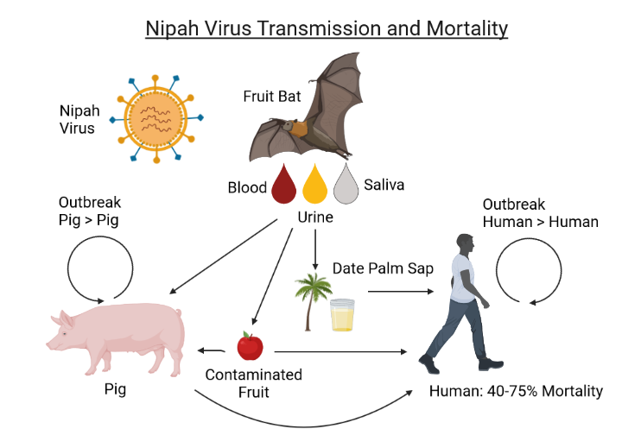
TRANSMISSION
DIRECT CONTACT with body fluids (Blood, Urine or Saliva) of infected animals
CONSUMING FOOD PRODUCT - palm sap or fruit contaminated by an infected bat
CLOSE CONTACT with infected person or their body fluids (respiratory droplets, urine, or blood)

Slide 8
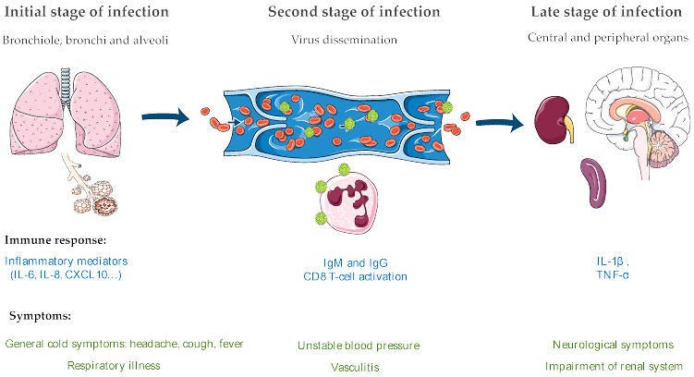
PATHOGENESIS

Slide 9
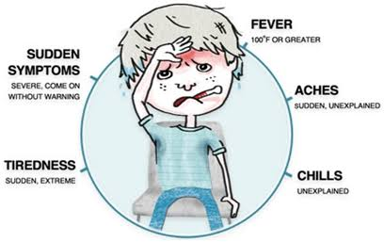
CLINICAL FEATURES
Incubation Period : 6-21 days
Fever, Altered mental status, Severe weakness, Headache, Respiratory distress, Cough, Vomiting, Muscle pain, Convulsion, Diarrhoea
Syndromic Presentations - ARDS, Myocarditis and Encephalitis.
Encephalitis and seizures occur in severe cases, progressing to coma within 24 to 48 hours.
Patients can present with fever alone
Any patient coming with fever & any other symptom with an epidemiological link & contact H/O must be treated as NiV infection

Slide 10
Any patient coming with fever & any other symptom with an epidemiological link & contact H/O must be treated as NiV infection
In general, the case fatality rate is estimated at 40 to 75%, however , this rate can vary by outbreak and can be upto 100%.

Slide 11
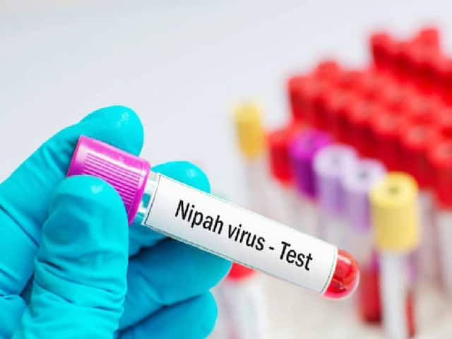
DIAGNOSIS
DEFINITIVE DIAGNOSIS
Demonstration of Virus in body fluids : RT-PCR Viral RNA
SEROLOGICAL TESTING
IgM ELISA - First line Serological Diagnostic Test
Confirmatory - Detection of Neutralizing Antibodies against Nipah virus in serum
Nipah virus is classified internationally as a biosafety level 4.
In India, testing facility is available at mational institute of virology (NIV) at Pune.

Slide 12
TREATMENT
NO APPROVED DRUG SO FAR
Standard care must be provided as in any other infection presenting with Encephalitis, ARDS, and or Myocarditis.
Available Options - Ribavirin / Monoclonal antibody m102.4

Slide 13
m102. 4 - Monoclonal Antibody
m102.4 binds to the immunodominant NiV receptor-binding glycoprotein (GP), and neutralizes NiV,
The compassionate use has been approved by the government, it will be the choice of the patient and their family whether they take it.
There have been no trials because several cases of the infection are needed to do so.

Slide 14
Case definition:
Suspected Nipah case:
person from a community affected by a Nipah virus disease outbreak has
1. fever with new onset of altered mental status or seizure and/or
2. fever with headache and /or
3. fever with cough or SOB

Slide 15
Probable Nipah case:
Suspect case- patient who resided in the village/ ward, where suspect /confirmed case of Nipah were living during the outbreak period and who died before complete diagnostic specimens could be collected
OR
Suspected case – patients who came in direct contact with confirmed case- patients in a hospital setting during the outbreak period and who died before completing diagnostic specimens could be collected.

Slide 16
Confirmed Nipah case:
Suspected case who has laboratory confirmation of Nipah virus infection either by,
Nipah Virus RNA identified by PCR from respiratory secretions, urine or CSF
Isolation of Nipah virus from respiratory secretions, urine or CSF.

Slide 17
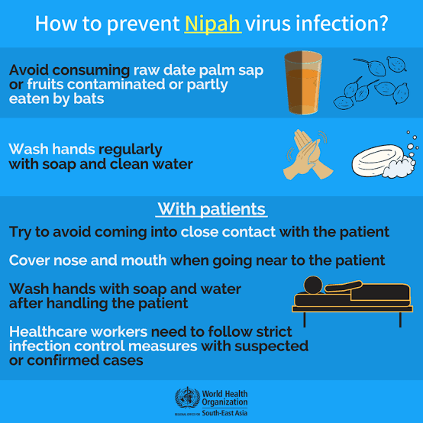
PREVENTIVE MEASURES
Practice handwashing regularly with soap and water
Avoid contact with sick bats or pigs
Avoid areas where bats are known to roost
Avoid eating or drinking products that could be contaminated by bats, such as raw date palm sap, raw fruit
Avoid contact with the blood or body fluids of any person known to be infected with NiV

Slide 18
Thank you

